Slide 1
Digital Marketing Insights
By - Nikhil Nair

Slide 2
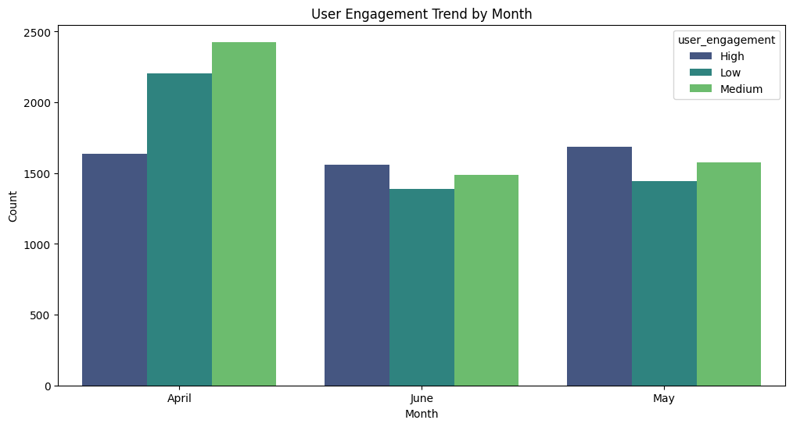
We observe an overall decrease in User Engagement from months April-June.

Slide 3
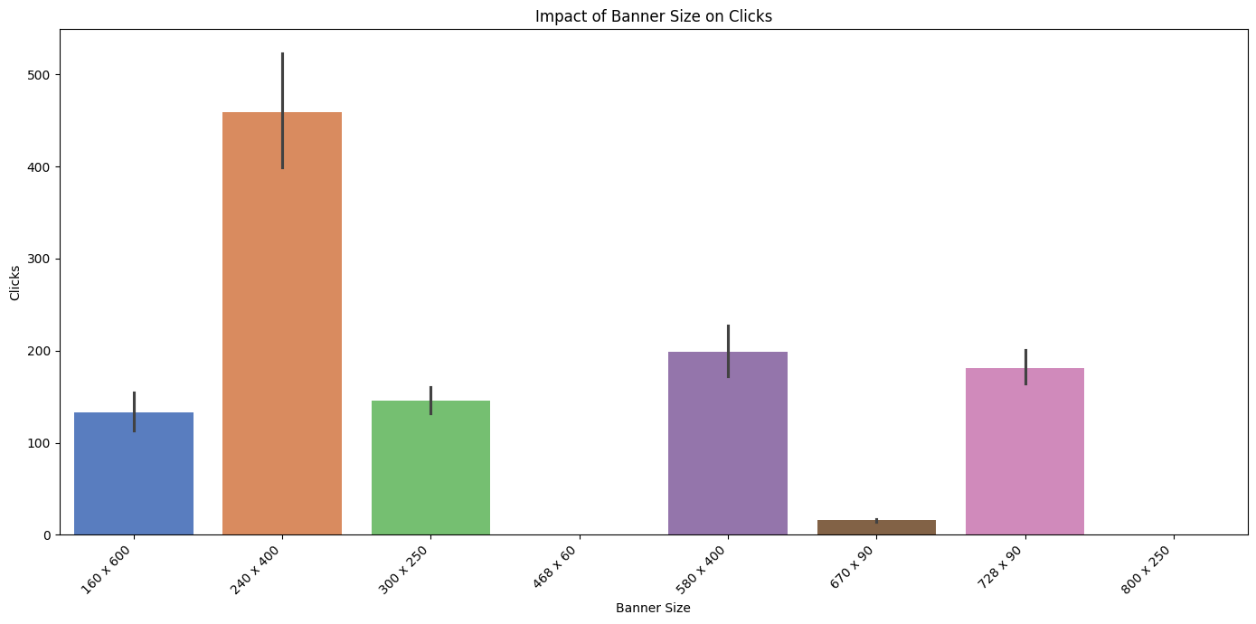
240x400 banner size generated the maximum clicks.

Slide 4
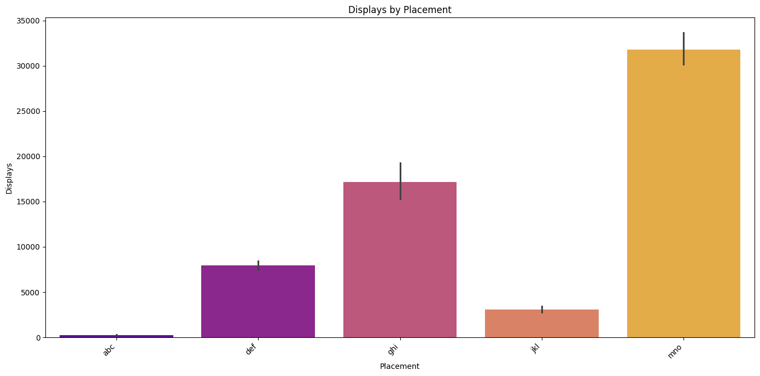
‘mno’ secures the maximum displays.

Slide 5
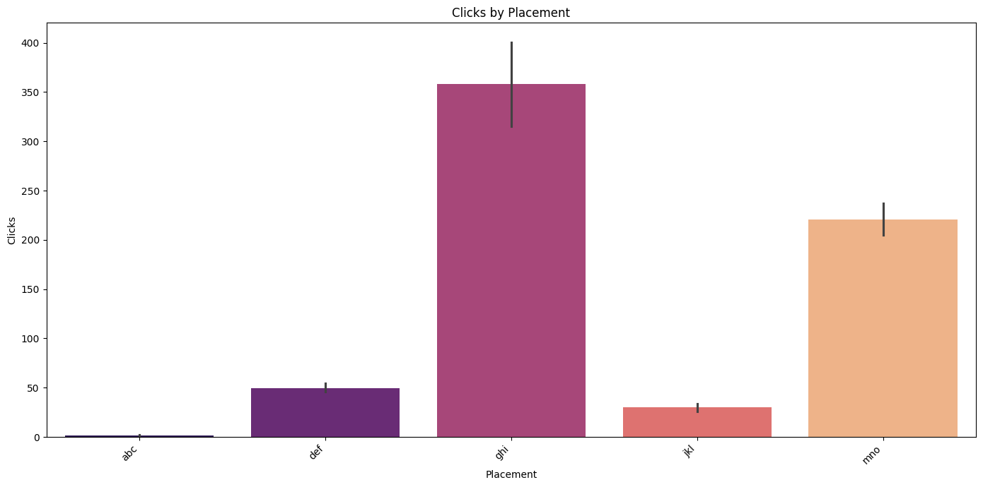
‘ghi’ secures the maximum clicks.

Slide 6
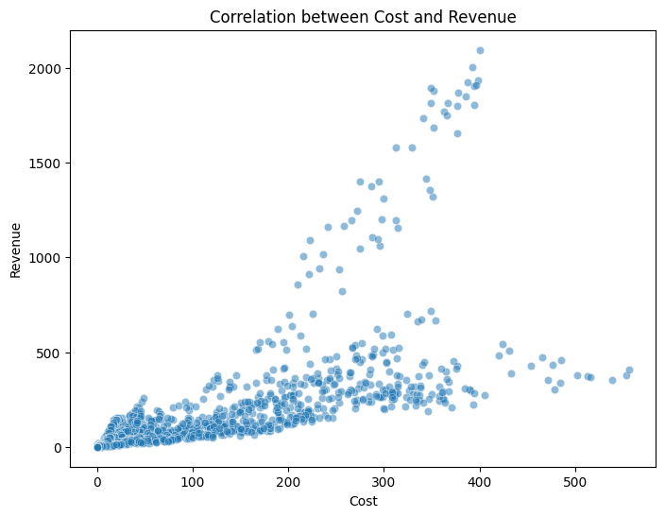
Positive correlation between cost and revenue upto a cost of 400.

Slide 7
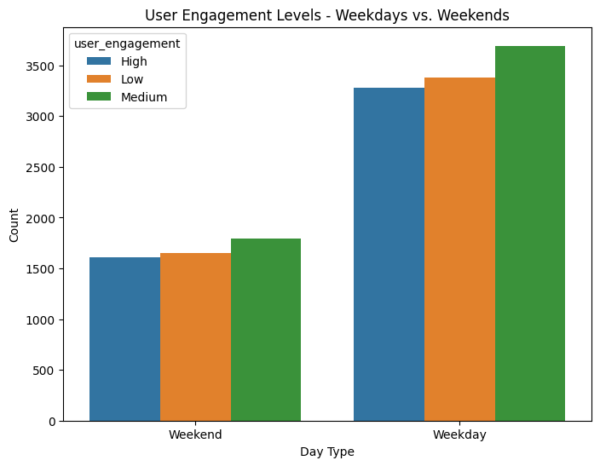
Significantly higher user engagement on Weekdays as compared to the Weekends.

Slide 8
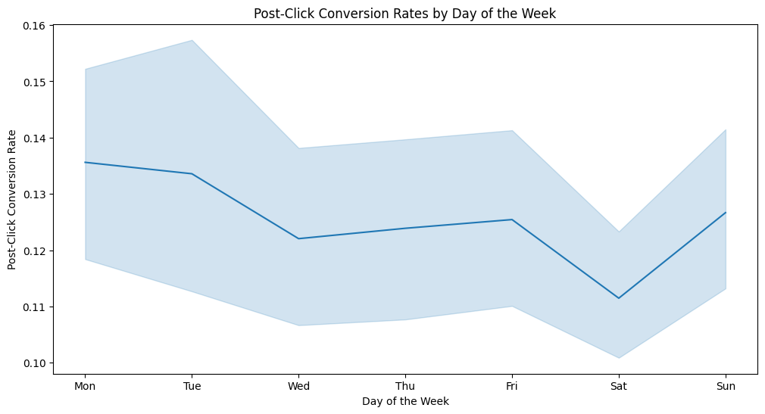
Overall decrease from Monday to Sunday.

Slide 9
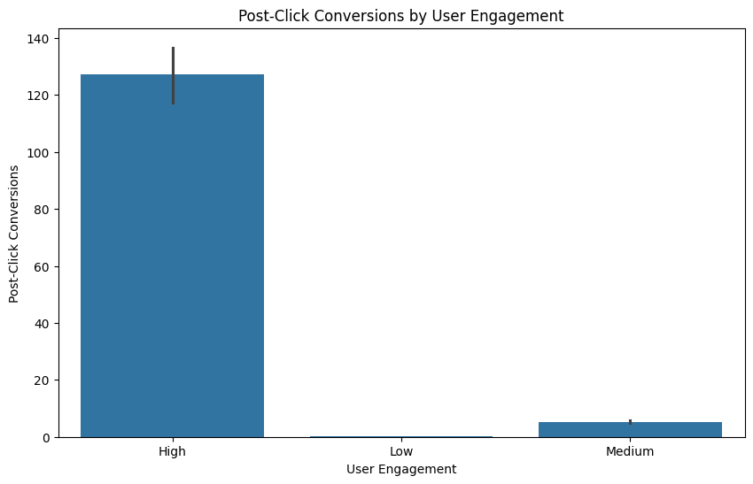
High user engagement directly corresponds to higher post-click conversions.

Slide 10
Thank You!

